Slide 1
Chapter 24
Electric Potential

Slide 2



Electric Potential:
The potential energy per unit charge at a point in an electric field is called the electric potential V (or simply the potential) at that point. This is a scalar quantity. Thus,
The electric potential difference V between any two points i and f in an electric field is equal to the difference in potential energy per unit charge between the two points. Thus,
The potential difference between two points is thus the negative of the work done by the electrostatic force to move a unit charge from one point to the other.

Slide 3
Electric Potential
The potential energy per unit charge at a point in an electric field is called the electric potential V (or simply the potential) at that point. This is a scalar quantity. Thus,

Slide 4
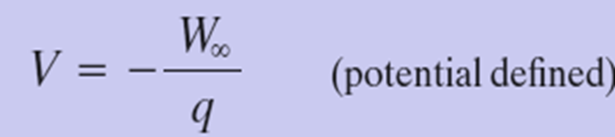
Electric Potential
If we set U_{i} =0 at infinity as our reference potential energy, then the electric potential V must also be zero there. Therefore, the electric potential at any point in an electric field can be defined to be

Slide 5

Electric Potential
Here W∞ is the work done by the electric field on a charged particle as that particle moves in from infinity to point f.
The SI unit for potential is the joule per coulomb. This combination is called the volt (abbreviated V).

Slide 6
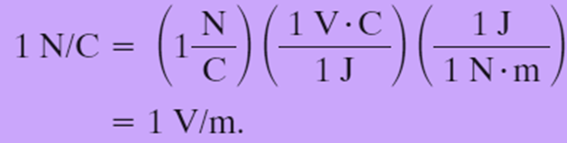
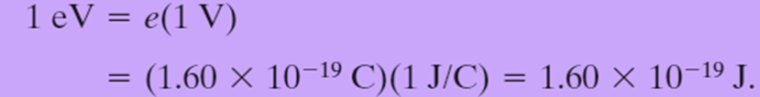
24.3 Electric Potential: Units:
This unit of volt allows us to adopt a more conventional unit for the electric field, E, which is expressed in newtons per coulomb.
We can now define an energy unit that is a convenient one for energy measurements in the atomic/subatomic domain: One electron-volt (eV) is the energy equal to the work required to move a single elementary charge e, such as that of the electron or the proton, through a potential difference of exactly one volt. The magnitude of this work is qΔV, and

Slide 7




Electric Potential: Work done by an Applied Force:
If a particle of charge q is moved from point i to point f in an electric field by applying a force to it, the applied force does work W_{app} on the charge while the electric field does work W on it. The change K in the kinetic energy of the particle is
If the particle is stationary before and after the move, Then K_{f} and K_{i} are both zero.
Relating the work done by our applied force to the change in the potential energy of the particle during the move, one has
We can also relate W_{app} to the electric potential difference ΔV between the initial and final locations of the particle:

Slide 8
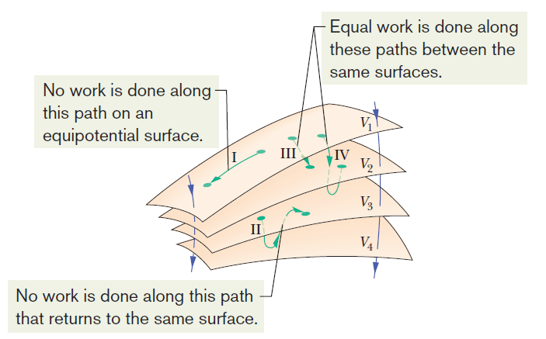
24.4 Equipotential Surfaces:
Adjacent points that have the same electric potential form an equipotential surface, which can be either an imaginary surface or a real, physical surface.
No net work W is done on a charged particle by an electric field when the particle moves between two points i and f on the same equipotential surface.
Fig. 24-2 Portions of four equipotential surfaces at electric potentials V₁=100 V, V₂=80 V,V₃ =60 V, and V₄ =40 V. Four paths along which a test charge may move are shown. Two electric field lines are also indicated.

Slide 9
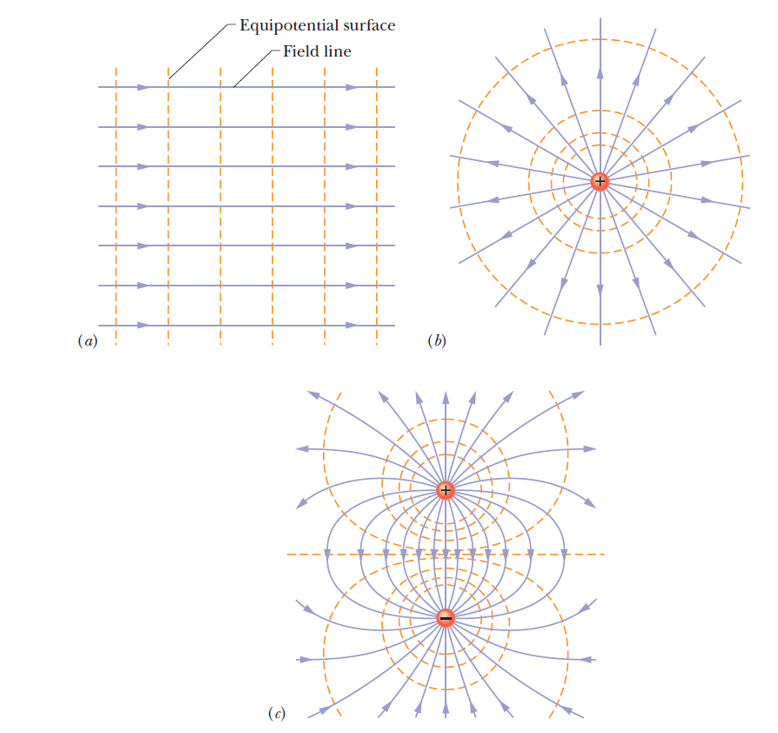
24.4 Equipotential Surfaces:
Fig. 24-3 Electric field lines (purple) and cross sections of equipotential surfaces (gold) for (a) a uniform electric field, (b) the field due to a point charge, and (c) the field due to an electric dipole.

